Slide 1
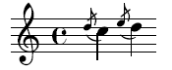
Grace: Safe Multithreaded Programming for C/C++
Emery Berger
University of Massachusetts, Amherst
www.cs.umass.edu/~emery

Slide 3
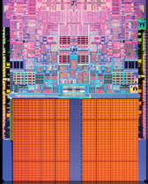

Slide 15
color = ; row = 0; // globals
void nextStripe(){
for (c = 0; c < Width; c++) {
drawBox (c,row,color);
}
color = (color == )?  : ; row++;
}
for (n = 0; n < 9; n++) {
nextStripe();
}

Slide 17


Slide 18


Slide 24
color = ; row = 0; // globals
void nextStripe(){
for (c = 0; c < Width; c++) {
drawBox (c,row,color);
}
color = (color == )?  : ; row++;
}
for (n = 0; n < 9; n++) {
spawn nextStripe();
}
sync;

Slide 25

“
”

Slide 31
race condition

Slide 32
color = ; row = 0; // globals
void nextStripe(){
for (c = 0; c < Width; c++) {
drawBox (c,row,color);
}
color = (color == )?  : ; row++;
}
for (n = 0; n < 9; n++) {
spawn nextStripe();
}
sync;

Slide 33
color = ; row = 0; // globals
void nextStripe(){
for (c = 0; c < Width; c++) {
drawBox (c,row,color);
}
color = (color == )?  : ; row++;
}
for (n = 0; n < 9; n++) {
spawn nextStripe();
}
sync;

Slide 34
color = ; row = 0; // globals
void nextStripe(){
for (c = 0; c < Width; c++) {
lock(); drawBox (c,row,color); unlock();
}
lock();
color = (color == )?  : ; row++;
unlock();
}
for (n = 0; n < 9; n++) {
spawn nextStripe();
}
sync;

Slide 39
atomicity violation

Slide 40
color = ; row = 0; // globals
void nextStripe(){
for (c = 0; c < Width; c++) {
lock(); drawBox (c,row,color); unlock();
}
lock();
color = (color == )?  : ; row++;
unlock();
}
for (n = 0; n < 9; n++) {
spawn nextStripe();
}
sync;

Slide 41
color = ; row = 0; // globals
void nextStripe(){
lock();
for (c = 0; c < Width; c++) {
drawBox (c,row,color);
}
color = (color == )?  : ; row++;
unlock();
}
for (n = 0; n < 9; n++) {
spawn nextStripe();
}
sync;

Slide 44
deadlock

Slide 48
order violation

Slide 50
sequential

Slide 51

sequential

Slide 53
race conditions

Slide 54
race conditions
atomicity violations

Slide 55
race conditions
atomicity violations
deadlock

Slide 56
race conditions
atomicity violations
deadlock
order violations

Slide 57


Slide 58
race conditions
atomicity violations
pthreads
deadlock
order violations
% g++ myprog.cpp –lpthread –o myprog

Slide 59
Grace
“sequential”
% g++ myprog.cpp –lgrace –o myprog

Slide 60
Grace
1.
sequential
+
?

Slide 61
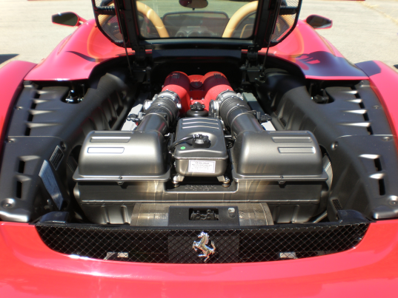
Grace
1.
sequential
+
?
2.

Slide 62
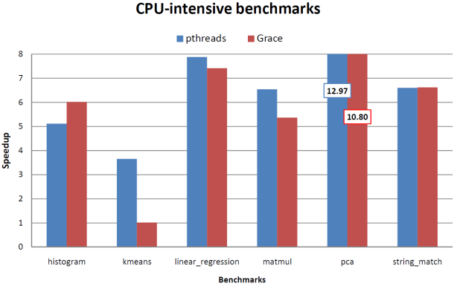
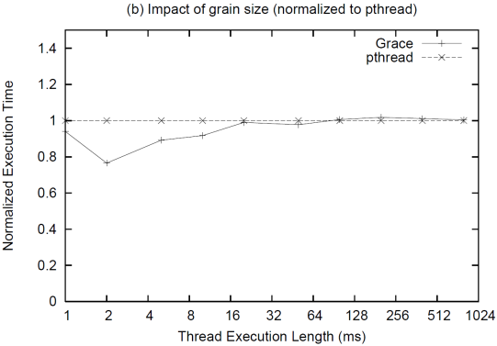
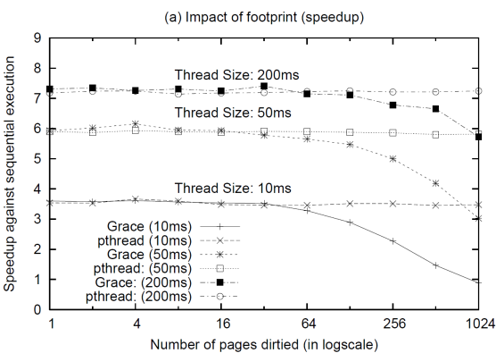
Grace
1.
sequential
+
?
2.
3.

Slide 63
1.
sequential
+
?

Slide 64
1.
sequential
+
?
t1 = spawn f(x);
t2 = spawn g(y);
sync;

Slide 65
1.
sequential
+
?
spawn f(x)
t1 = spawn f(x);
t2 = spawn g(y);
sync;

Slide 66

1.
sequential
+
?
spawn f(x)
t1 = spawn f(x);
t2 = spawn g(y);
sync;
f(x)

Slide 67
1.
sequential
+
?
spawn f(x)
t1 = spawn f(x);
t2 = spawn g(y);
sync;
f(x)
spawn g(y)

Slide 68
1.
sequential
+
?
spawn f(x)
t1 = spawn f(x);
t2 = spawn g(y);
sync;
f(x)
spawn g(y)
g(y)

Slide 69
1.
sequential
+
?
spawn f(x)
t1 = spawn f(x);
t2 = spawn g(y);
sync;
f(x)
spawn g(y)
g(y)
sync

Slide 70
1.
sequential
+
?
spawn f(x)
t1 = spawn f(x);
t2 = spawn g(y);
sync;
f(x)
spawn g(y)
g(y)
sync

Slide 71
1.
sequential
+
?
f(x)
t1 = spawn f(x);
t2 = spawn g(y);
sync;
g(y)

Slide 72
1.
sequential
+
?
“
f(x)
”
t1 = spawn f(x);
t2 = spawn g(y);
sync;
g(y)

Slide 73
1.
sequential
+
?
“
f(x)
”
g(y)

Slide 74
1.
sequential
+
?
“
f(x)
”
race conditions
g(y)
atomicity violations
deadlock
order violations

Slide 75
1.
sequential
+
?
“
f(x)
”
race conditions
g(y)
atomicity violations
deadlock
order violations

Slide 76
1.
sequential
+
?
“
f(x)
”
race conditions
g(y)
atomicity violations
deadlock
order violations

Slide 77

1.
sequential
+
?
“
f(x)
”
race conditions
g(y)
atomicity violations
deadlock
order violations

Slide 78
1.
sequential
+
?
“
f(x)
”
race conditions
g(y)
atomicity violations
deadlock
order violations

Slide 79
1.
sequential
+
?
“
f(x)
”
race conditions
g(y)
atomicity violations
deadlock
order violations

Slide 80
1.
sequential
+
?
“
f(x)
”
race conditions
g(y)
atomicity violations
deadlock
order violations

Slide 81

1.
sequential
+
?
“
f(x)
”
g(y)

Slide 82
1.
sequential
+
?
“
f(x)
”
g(y)

Slide 83

1.
sequential
+
?
“
f(x)
”
g(y)

Slide 84
1.
sequential
+
?
“
f(x)
”
g(y)

Slide 85

1.
sequential
+
?
“
f(x)
”
g(y)
Fork-join (MapReduce, Cilk, TBB, OpenMP)

Slide 86
2.
?

Slide 87

2.
?

Slide 88

2.
?
t1 = spawn f(x);
t2 = spawn g(y);
sync;

Slide 89

2.
?
t1 = spawn f(x);
t2 = spawn g(y);
sync;
if (!fork())
f(x);
if (!fork())
g(y);
// check;

Slide 90
spawn f(x)
2.
?
f(x)
spawn g(y)
g(y)
sync
if (!fork())
f(x);
if (!fork())
g(y);
// check;

Slide 91

spawn f(x)
2.
?
f(x)
spawn g(y)
g(y)
sync
if (!fork())
f(x);
if (!fork())
g(y);
// check;

Slide 92
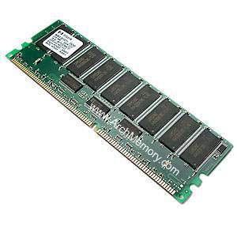
spawn f(x)
2.
?
f(x)
spawn g(y)
g(y)
mmap
sync
isolation + per-thread page protection

Slide 93
spawn f(x)
2.
?
f(x)
spawn g(y)
g(y)
mmap
sync
isolation + per-thread page protection

Slide 94

spawn f(x)
2.
?
f(x)
spawn g(y)
g(y)
sync

Slide 95
spawn f(x)
2.
?
f(x)
spawn g(y)
g(y)
sync
1

Slide 96
spawn f(x)
2.
?
f(x)
spawn g(y)
g(y)
sync
1
sequential
ordering of state
2

Slide 97


2.
?
scalable heap + aligned globals I/O (buffering + ordering)

Slide 98
3.

Slide 99


Safe and (usually) fast*
*1—16 lines changed

Slide 100

Grace
sequential
race conditions
atomicity violations
deadlock
order violations
% g++ myprog.cpp –lgrace –o myprog

Slide 102
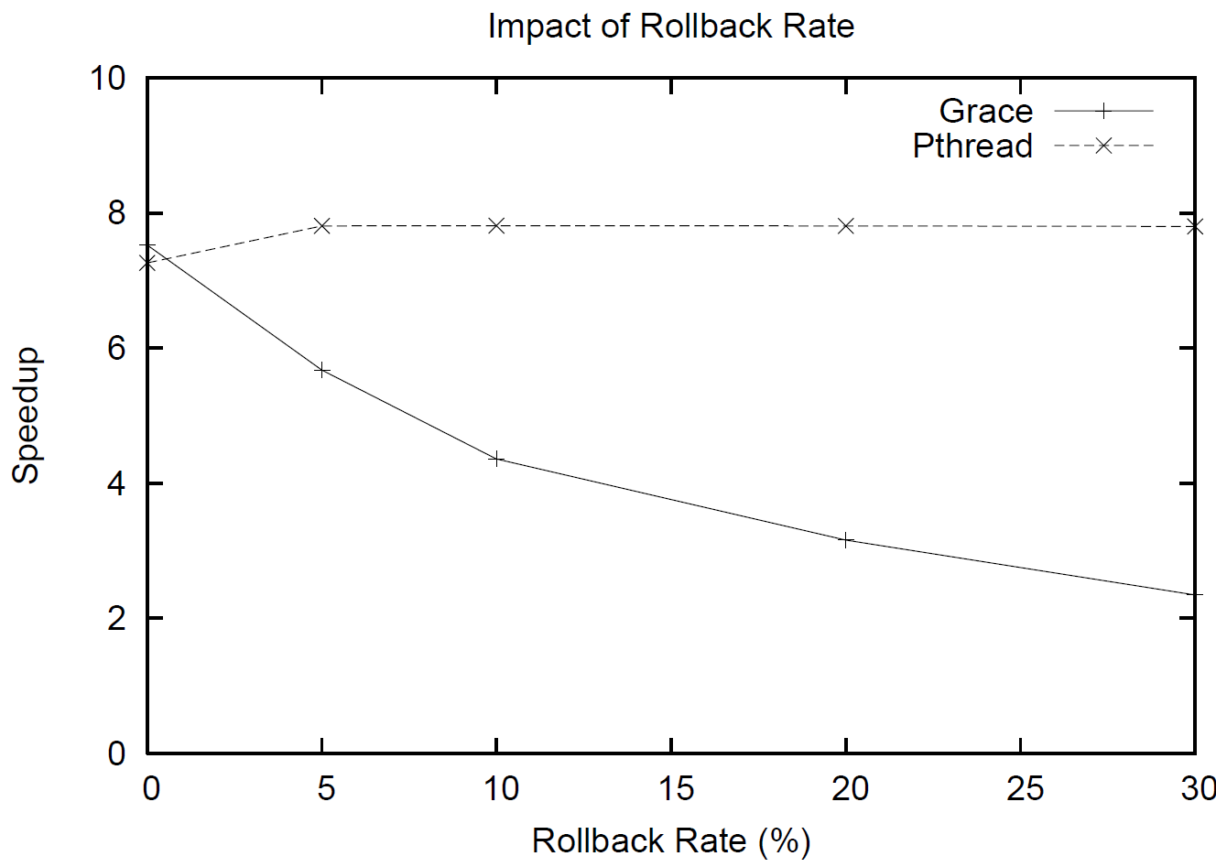

Slide 103

Garbage Collection

Slide 104
Garbage Collection
Idea: robot takes care of your garbage

Slide 105
Garbage Collection
Idea: runtime takes care of your memory errors
= no crashes/vulnerabilities

Slide 106
Garbage Collection
Result: success story!

Slide 107

“Garbage Collection for Concurrency”

Slide 108
“Garbage Collection for Concurrency”
Goal: You write concurrent programs
with as many bugs as you want!
Wall-E cleans up after you

Slide 109
“Garbage Collection for Concurrency”
How do I “garbage collect” concurrency errors?

